Slide 1


CDSAML- CCBD Summer 2024
Internship Project - Second Review
Authorship Attribution: Identifying Writers Through Image Analysis
Prof Chandravva Hebbi
Suraj Nagisetty(PES1UG22AM901)
Bharatheesha LVN (PES1UG22AM088) G S Datta Praneeth(PES1UG22AM060)

Slide 2
Outline
Abstract
Motivation behind the project Literature survey
About the model Applications Results

Slide 3
Problem statement
Objective: To develop a system that can analyze handwriting to identify the writer.
Challenges:
Detecting handwritten characters accurately.
Identifying the writer based on handwriting style.
Ensuring high accuracy for writer identification.

Slide 4
Scope and feasibility
Scope:
Use of CNN for writer identification.
Outputs the class name of the author
Feasibility:
Available datasets for training both models.
Changes are made to the dataset to suit the CNN approach
Writer identification can leverage CNN-based approaches.

Slide 5
Abstract
We present a deep learning approach for authorship detection of handwritten Kannada characters. We have developed a Convolutional Neural Network (CNN) model to classify handwritten Kannada alphabets based on the author's identity. Our dataset consists of images of handwritten Kannada characters from multiple authors, each assigned a unique identifier.
The proposed model achieves 64% accuracy on the test set, demonstrating the potential of CNNs in identifying authorship patterns in Kannada handwriting. This research contributes to the field of digital forensics and handwriting analysis, particularly for Indic scripts, and has potential applications in document verification and historical manuscript analysis.

Slide 6
Motivation behind the project
Our literature review revealed a paucity of publications on this topic, particularly regarding South Indian languages. The scarcity of research in this area, especially concerning Kannada handwriting, presented a compelling opportunity for investigation. Consequently, we embarked on developing a model capable of identifying writers based on their Kannada handwriting samples.
This approach not only addresses a gap in the current body of knowledge but also contributes to the broader field of handwriting analysis and author identification in linguistically diverse contexts.

Slide 7
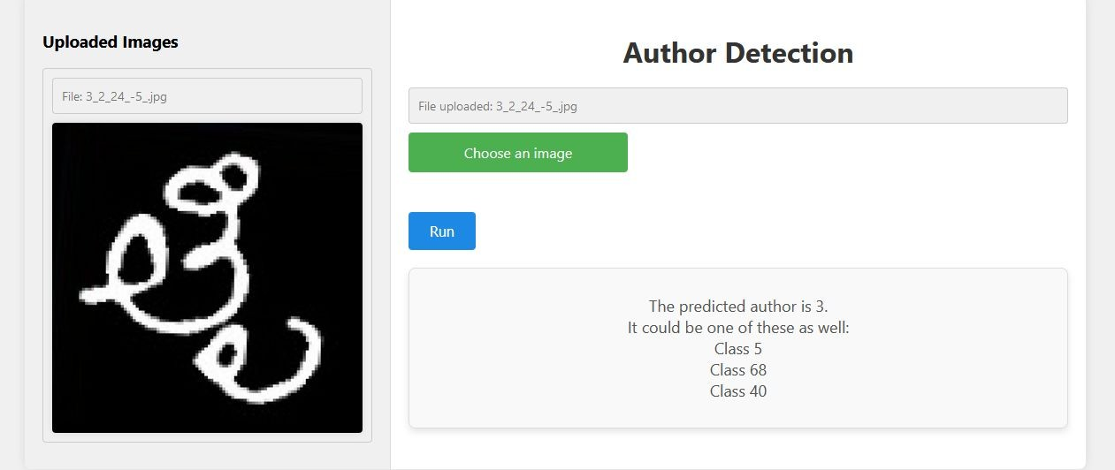
User friendly & interactive
A simple and easy to use interface where the user can simply upload an image, and on clicking the “run” button, will be able to execute the program with ease

Slide 8
Literature survey
paper -1 :Offline text-independent writer identification using a codebook with structural features
Authors: Bashar Q. Ahmed, Yaser F. Hassan, Ashraf S. Elsayed Year of Publication: 2023
Datasets Used: The authors used two large and publicly accessible datasets: the Arabic KHATT dataset and the English IAM dataset. The KHATT dataset includes various handwriting samples from 1,000 participants, while the IAM dataset contains handwritten English text from multiple writers.
Summary:This study proposes a writer identification system for handwritten documents using structural features. It extracts contour point curve angle (CPCA) and contour point concavity/convexity (CON3) features from segmented handwritten contours. These features are used to create a codebook via k-means clustering, and feature vectors are generated from occurrence histograms.

Slide 9
Literature survey
paper -2 :A Contour Texture-Based Approach for Off-Line Handwritten Text Writer Identification
Authors: T. Bahram
Year of Publication: 2022
IAM Database: A large and commonly used modern English handwritten text benchmark with 1,539 forms written by 657 different writers, scanned at 300 dpi. Firemaker Database: Contains 1,000 writing pages by 250 Dutch persons, each providing four different handwritten samples, scanned at 300 dpi.
Summary:This paper introduces a new textural feature named Modified Local Binary Pattern with Ink-trace Width and Shape Letters (MLBP-IWSL) for off-line handwritten text writer identification. The approach captures writer-specific details like ink trace direction, curvature, slant, width, and shapes by using a co-occurrence feature that combines MLBP and IWSL measurements.

Slide 10
Literature survey
paper -3 : A new method for writer identification based on historical documents
Authors: Abdeljalil Gattal, Chawki Djeddi, Faycel Abbas, Imran Siddiqi, and Brahim Bouderah Year of Publication: 2023
Dataset: The study uses the ICDAR 2017 Historical Writer Identification dataset, which contains 3,600 historical manuscripts from 720 unique writers, with 5 pages per writer.
Summary:
This paper proposes a new method for writer identification in historical documents using textural features and a novel moment-based matching technique. The authors extract oriented Basic Image Features (oBIFs) and hinge features from handwriting samples, and introduce a new moment-based distance measure to compare feature vectors.

Slide 11
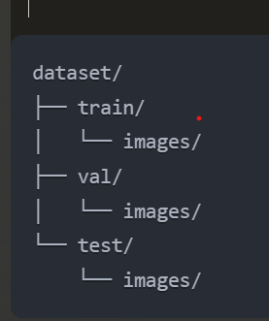
Dataset

Slide 12
About our model
model input and output : User Interface and Input Handling:
The system accepts user inputs via a web-based interface, including the ability to upload images.
This code implements a Convolutional Neural Network (CNN) for authorship detection using handwritten images. It defines a custom data generator to load and preprocess images, extracts author IDs from filenames, and creates a CNN model with multiple convolutional layers, batch normalization, and dense layers. The model is trained on a dataset split into training, validation, and test sets, using sparse categorical cross entropy loss and Adam optimizer. After training, the model is evaluated on the test set and saved for future use."

Slide 13
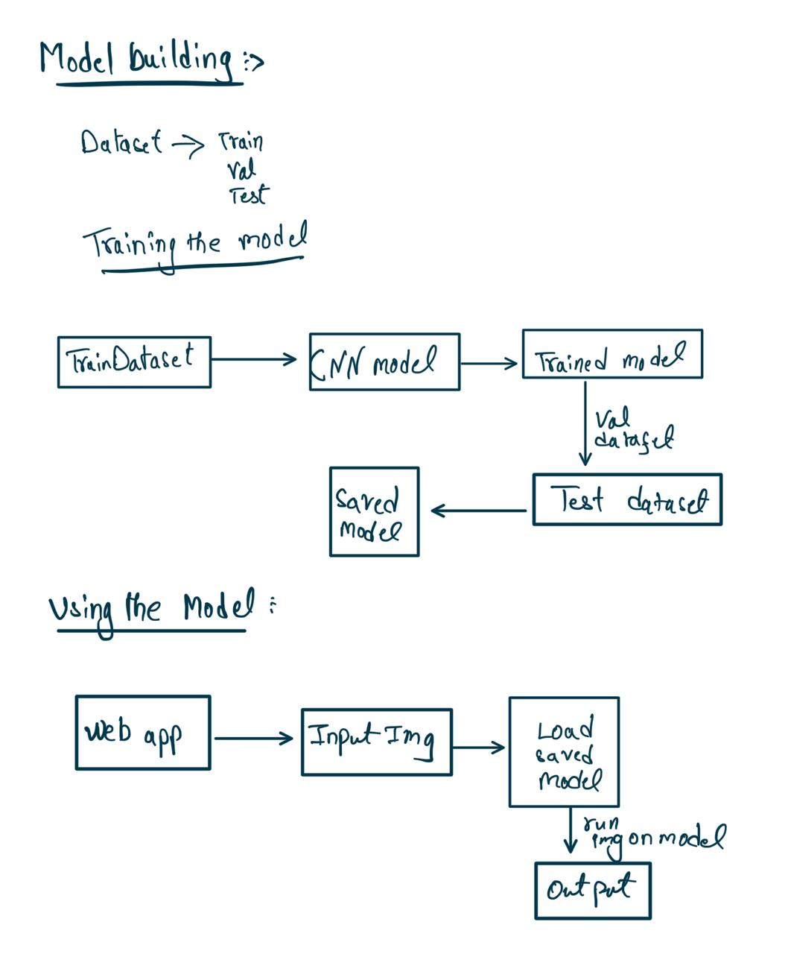
Model workflow

Slide 14

Applications
Forensic Analysis: Identifying the author of handwritten notes in forensic investigations.
Educational Tools: Assisting in handwriting assessments and personalized feedback for students.
Digital Archiving: Cataloging handwritten historical documents by both content and author.
Personalized Authentication: Enhancing security systems through handwriting-based authentication.

Slide 15
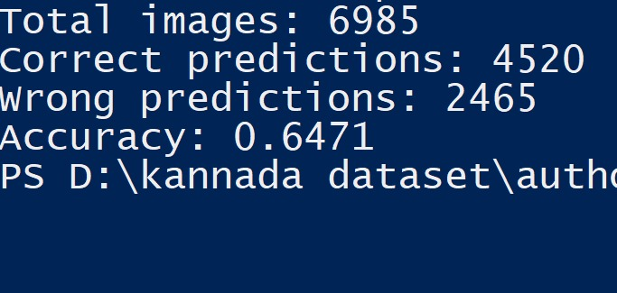
Results
Our model achieved a promising accuracy of 64%, a notable result given the constraints of our dataset.
This performance is particularly impressive considering each individual is represented by only a single handwriting sample. The potential for significant improvement is evident; with a more robust dataset featuring multiple samples per writer, we anticipate substantially higher accuracy rates. This initial success, achieved under limited conditions, underscores the model's potential and opens exciting avenues for future enhancements in handwriting-based writer identification.

